Slide 1
Rectifiers and Filters
PEE
FE CSBS

Slide 2
Why we go for power supply studies?
All electronic circuits need smooth DC power supply in order to function correctly.
The DC power supplied either from battery or power pack units

Slide 3
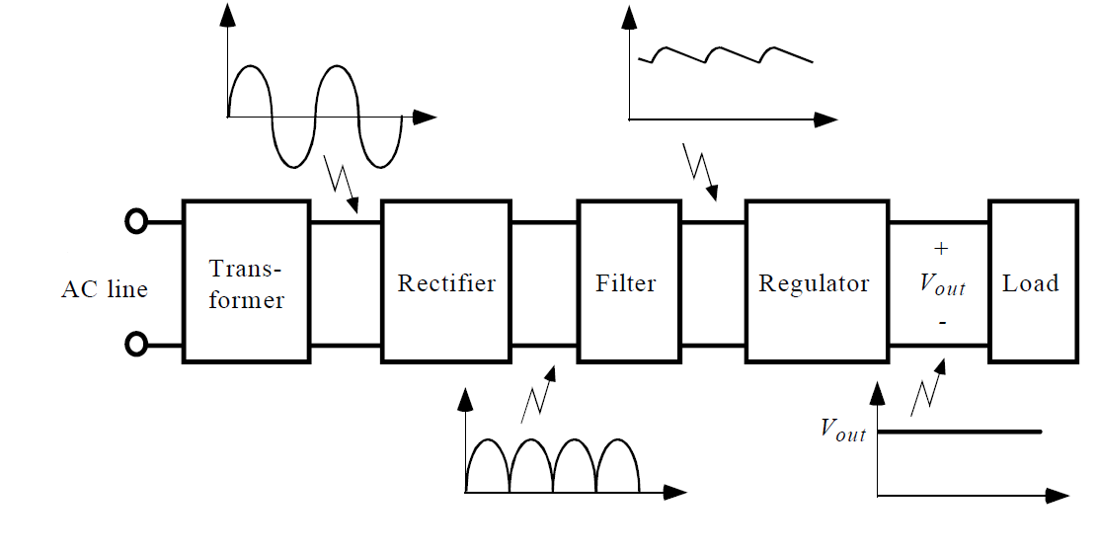
What is a Power Supply?
A device, which converts, regulates, and transmits the required power to the circuit to be operated

Slide 4
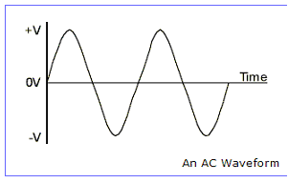
What is AC
The voltage (and current) alternates between positive and negative over time and the resulting waveform shape is a sine wave.

Slide 5
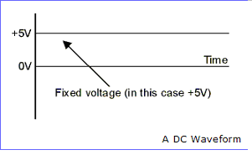
What is DC?
A Direct Current (DC) supply stays at a fixed, regular, voltage all of the time, like the voltage from a battery.

Slide 6
Elements of a Power Supply
Transformer
Rectifier
Filter
Regulator

Slide 7
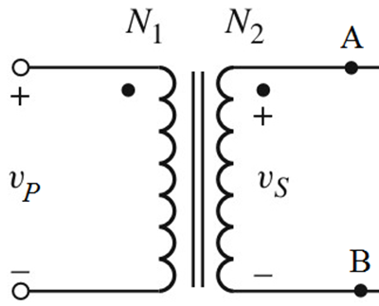
Transformer
The transformer is a device used to convert the ac line voltage to a voltage level more appropriate to the needs of the circuit to be operated
At the same time, the transformer provides electrical isolation between the ac line and the circuit to be operated.
This is an important safety consideration.
The output of the transformer is still an ac voltage, but now of an appropriate magnitude for the circuit to be powered.

Slide 8
Rectifiers
Rectifier is a device which convert AC voltage in to pulsating DC
A rectifier utilizes unidirectional conducting device Ex : P-N junction diodes

Slide 9
Important points to be studied while analyzing the various rectifiers
Rectifier efficiency
Peak value of the current
Peak value of the voltage
Ripple factor

Slide 10
Types
Depending up on the period of conduction
Half wave rectifier
Full wave rectifier
Depending up on the connection procedure
Bridge rectifier

Slide 11
Half wave rectifier
The ripple factor is quite high(1.21)
Rectifier efficiency is very low(40%)
TUF is low(0.21)
The half wave rectifier circuit is normally not used as a power rectifier circuit

Slide 12
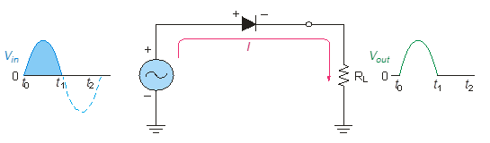
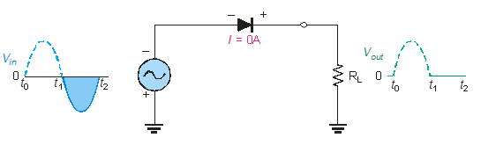
Half wave Rectifiers
Diodes conduct current in one direction and block in other.
When connected with ac voltage, diode only allows half cycle passing through it and hence convert ac into dc.
As the half of the wave get rectified, the process called half wave rectification.
Notes:
Random topics just for revising some concepts.

Slide 13
    A diode is connected to an ac source and a load resistor forming a half wave rectifier.
    Positive half cycle causes current through diode, that causes voltage drop across resistor.

Slide 14
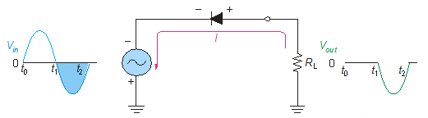
Diode as Rectifiers
Reversing diode.
Average value of Half wave output voltage:
VAVG = V_{m} / π
VAVG is approx 31.8% of Vm
PIV: Peak Inverse Voltage = Vm

Slide 15
Full wave rectifier
Ripple factor is (0.48)
Rectifier efficiency is high(81.2%)
TUF is high(0.693)

Slide 16
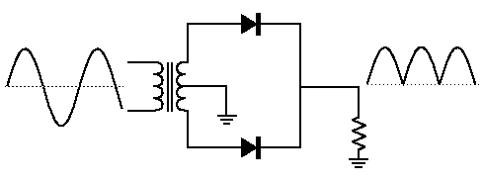
Full wave rectifiers
A full wave rectifier allows unidirectional current through the load during the entire 360 degree of input cycle.
The output voltage have twice the input frequency.
VAVG is 63.7% of V_{m},
V_{avg}=2V_{m}/ π
Full Wave Rectifier
Notes:
Random topics just for revising some concepts.

Slide 17
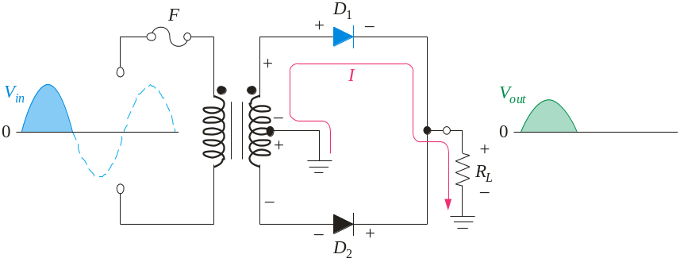
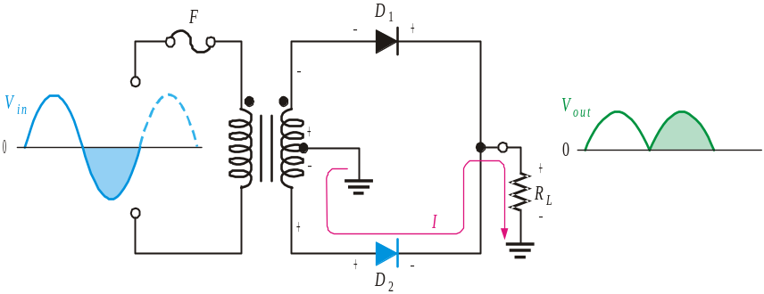
The Center-Tapped Full wave rectifiers
A center-tapped transformer is used with two diodes that conduct on alternating half-cycles.
During the positive half-cycle, the upper diode is forward-biased and the lower diode is reverse-biased.
During the negative half-cycle, the lower diode is forward-biased and the upper diode is reverse-biased.
Notes:
Random topics just for revising some concepts.

Slide 18
Bridge Rectifier
Suitable for applications where large powers are required

Slide 19
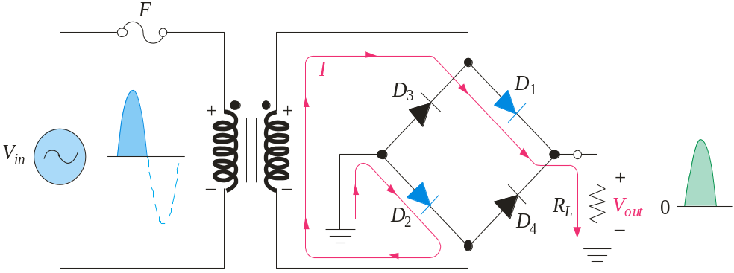
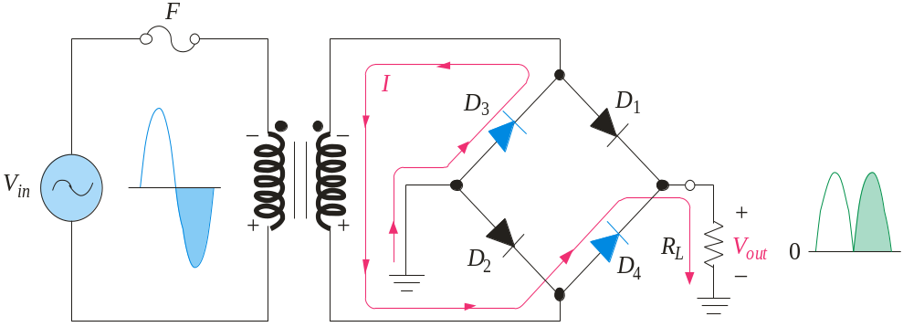
The Bridge Full-wave rectifiers
The Bridge Full-Wave rectifier uses four diodes connected across the entire secondary as shown.
Conduction path for the positive half-cycle.
Conduction path for the negative half-cycle.
Notes:
Random topics just for revising some concepts.

Slide 20

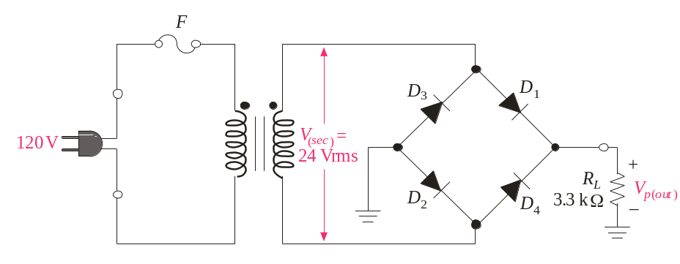


The Bridge Full-Wave Rectifier
Example:
Determine the peak output voltage and current in the 3.3 kΩ load resistor if V_{sec} = 24 V_{rms}. Use the practical diode model.
Solution:
The peak output voltage is:
= 32.5 V
Applying Ohm’s law,
I_{p(out)} = 9.8 mA

Slide 21





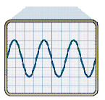
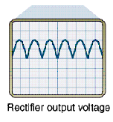
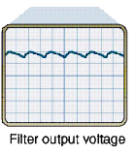
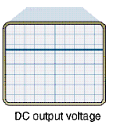
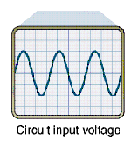
Block diagram of a Power Supply

Slide 22
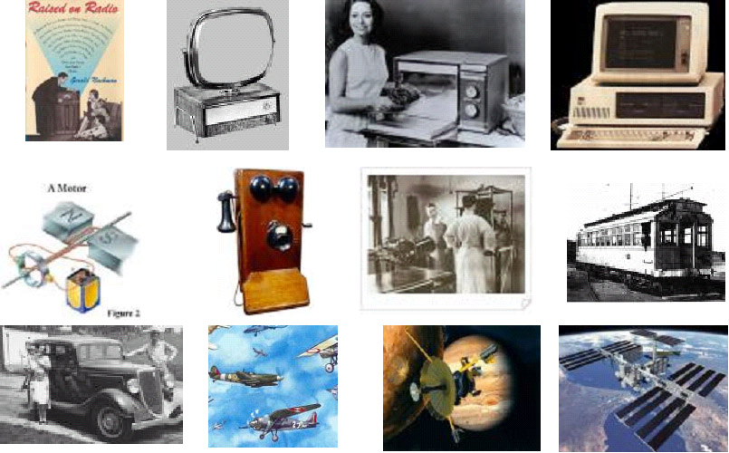
Fields?

Slide 23
Points to note…
The most important consideration in designing a power supply is the DC voltage at the output
It should be able to furnish the maximum current needed ,maintaining the voltage at constatnt level

Slide 24
Contd…
The AC ripple should be low
The power supply should be protect in the event of short circuit on the load side
The response of the power supply to temperature changes should be minimum

Slide 25
Filter Circuits
The output from the rectifier section is a pulsating DC.
The filter circuit reduces the peak-to-peak pulses to a small ripple voltage.

Slide 26
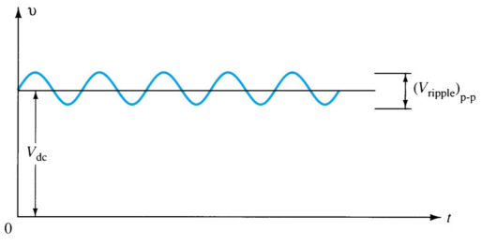
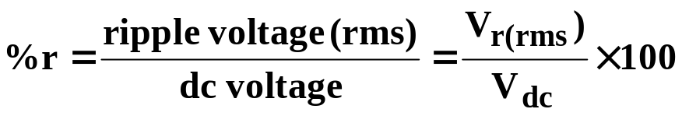
Ripple Factor
After the filter circuit a small amount of AC is still remaining. The amount of ripple voltage can be rated in terms of ripple factor (r).

Slide 27




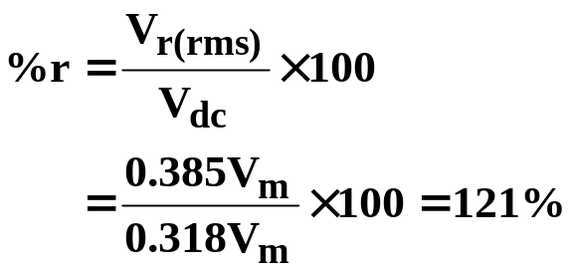
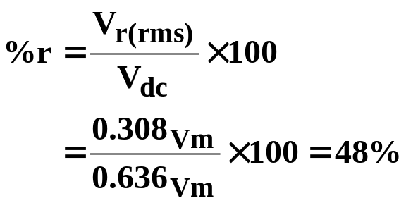
Rectifier Ripple Factor
Half-Wave
Full-Wave
DC output:
DC output:
AC ripple output:
AC ripple output:
Ripple factor:
Ripple factor:

Slide 28
Types of Filter Circuits
Capacitor Filter
RC Filter

Slide 29
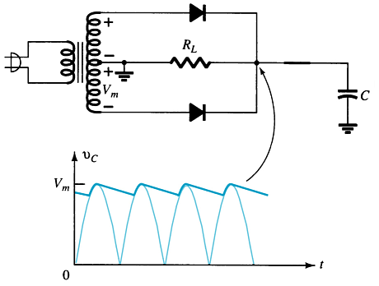
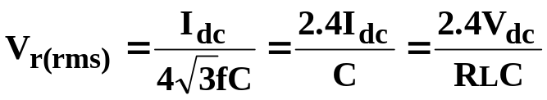
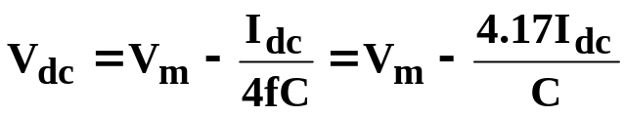
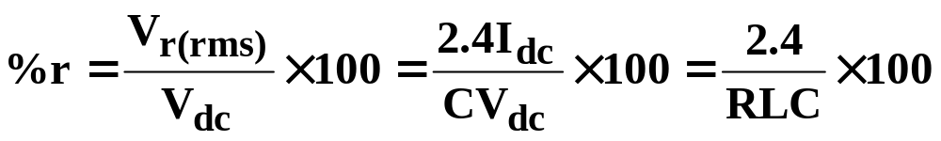
Capacitor Filter
Ripple voltage
The larger the capacitor the smaller the ripple voltage.
DC output
Ripple factor

Slide 30
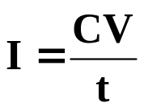
Diode Ratings with Capacitor Filter
The size of the capacitor increases the current drawn through the diodes—the larger the capacitance, the greater the amount of current.
Peak Current vs. Capacitance:
where
  C = capacitance
  V = change in capacitor voltage during charge/discharge
  t = the charge/discharge time

Slide 31
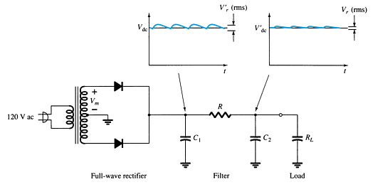
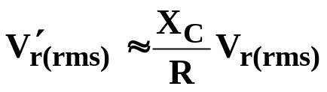
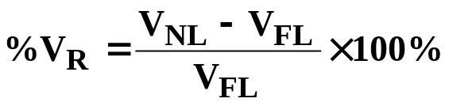
RC Filter Circuit
Adding an RC section further reduces the ripple voltage and decrease the surge current through the diodes.
V′_{r(rms)} = ripple voltage after the RC filter
V_{r(rms)} = ripple voltage before the RC filter
R = resistor in the added RC filter
X_{C} = reactance of the capacitor in the added RC filter
V_{NL} = no-load voltage
V_{FL} = full-load voltage

Slide 32
Voltage Regulation Circuits
There are two common types of circuitry for voltage regulation:
  Discrete Transistors
  IC’s

Slide 33
Discrete-Transistor Regulators
Series voltage regulator
Current-limiting circuit
Shunt voltage regulator

Slide 34
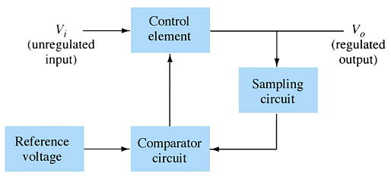
Series Voltage Regulator Circuit
The series element controls the amount of the input voltage that gets to the output.
If the output voltage increases (or decreases), the comparator circuit provides a control signal to cause the series control element to decrease (or increase) the amount of the output voltage.

Slide 35
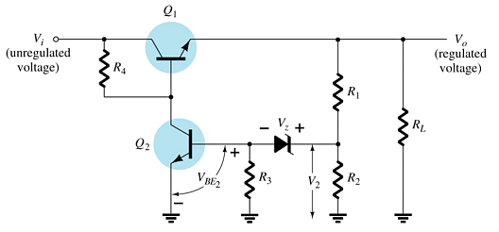
Series Voltage Regulator Circuit
R₁ and R₂ act as the sampling circuit
Zener provides the reference voltage
Q₂ controls the base current to Q₁
Q₁ maintains the constant output voltage
When the output increases:
  The voltage at V₂ and V_{BE} of Q₂ increases
  The conduction of Q₂ increases
  The conduction of Q₁ decreases
  The output voltage decreases
When the output decreases:
  The voltage at V₂ and V_{BE} of Q₂ decreases
  The conduction of Q₂ decreases
  The conduction of Q₁ increases
  The output voltage increases

Slide 36
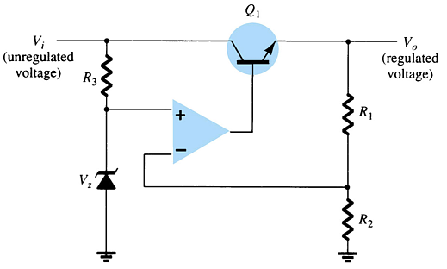
Series Voltage Regulator Circuit
The op-amp compares the Zener diode voltage with the output voltage (at R₁ and R₂) and controls the conduction of Q₁.

Slide 37
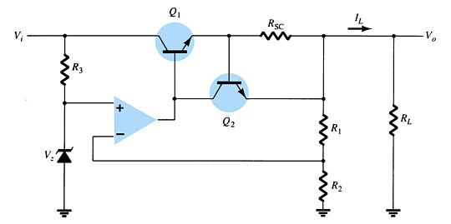
Current-Limiting Circuit
When I_{L} increases:
  The voltage across R_{SC} increases
  The increasing voltage across R_{SC} drives Q₂ on
  Conduction of Q₂ reduces current for Q₁ and the load

Slide 38
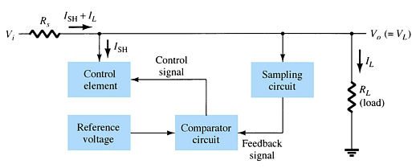
Shunt Voltage Regulator Circuit
The shunt voltage regulator shunts current away from the load.
The load voltage is sampled and fed back to a comparator circuit. If the load voltage is too high, control circuitry shunts more current away from the load.

Slide 39
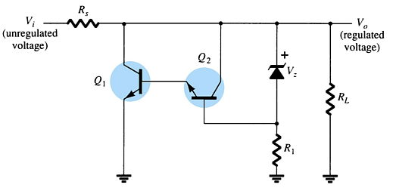
Shunt Voltage Regulator Circuit
When the output voltage increases:
  The Zener current increases
  The conduction of Q₂ increases
  The voltage drop at R_{s} increases
  The output voltage decreases
When the output voltage decreases:
  The Zener current decreases
  The conduction of Q₂ decreases
  The voltage drop at R_{s} decreases
  The output voltage increases

Slide 40
IC Voltage Regulators
Regulator ICs contain:
    Comparator circuit
    Reference voltage
    Control circuitry
    Overload protection
Types of three-terminal IC voltage regulators
    Fixed positive voltage regulator
    Fixed negative voltage regulator
    Adjustable voltage regulator

Slide 41
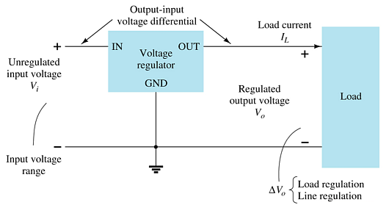
Three-Terminal Voltage Regulators
The specifications for this IC indicate:
  The range of input voltages that can be regulated for a specific range of output voltage and load current
  Load regulation—variation in output voltage with variations in load current
  Line regulation—variation in output voltage with variations in input voltage

Slide 42
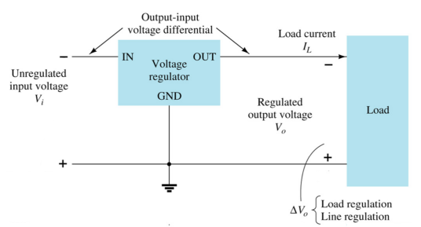
Fixed Negative Voltage Regulator
These ICs output a fixed negative output voltage.

Slide 43
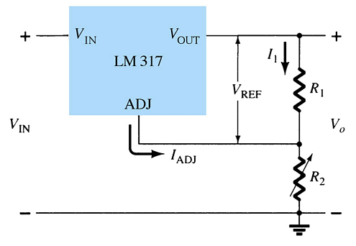
Adjustable Voltage Regulator
These regulators have adjustable output voltages.
The output voltage is commonly selected using a potentiometer.

Slide 44
Practical Power Supplies
DC supply (linear power supplies)
Chopper supply (switching power supplies)
TV horizontal high voltage supply
Battery chargers

Slide 45
        THANK YOU

